Slide 1
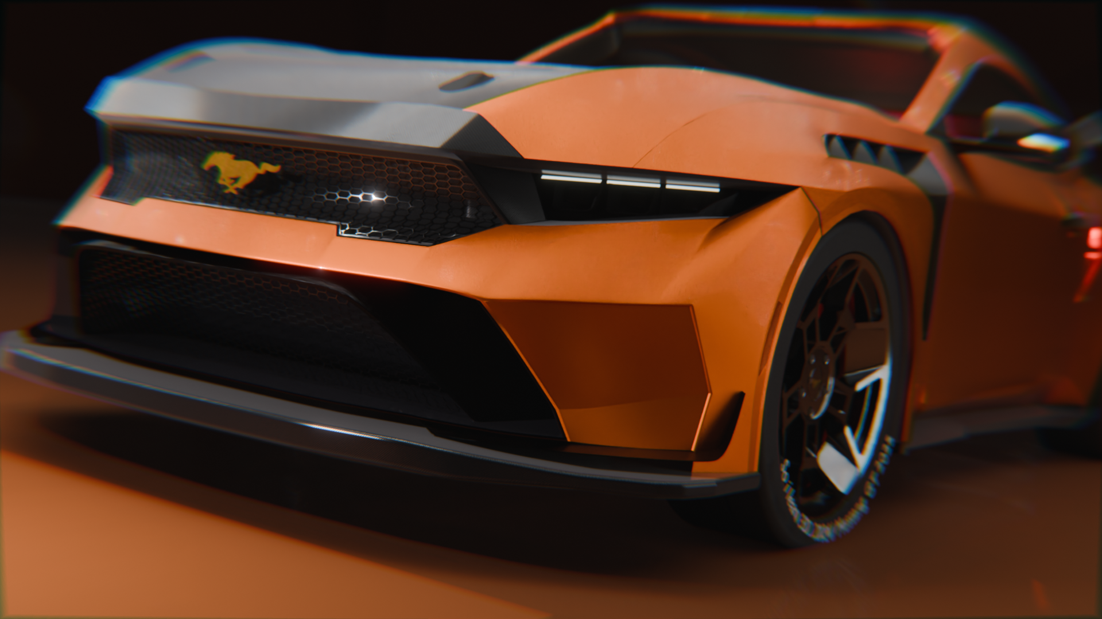
Exporting Design
This document outlines the various export options available in Fusion 360, catering to different needs and applications. From animation and product visualization to 3D printing and CAD, this guide provides a comprehensive overview of the most suitable formats for each purpose.

Slide 2
Fusion 360 Export
Fusion 360 offers a range of export options to suit various design needs. Here's a breakdown of the most common formats
and their applications ( some might not be available on fusion 360 but on others software):
Export for Animation
Export for Product Visualisation
Export for 3D Printing
Export for CAD (Computer Aided Design)
Export for Website
Export for Animation
Export for Product Visualisation
Export for 3D Printing
FBX format is the ideal choice for animation due to its ability to include the 3D model, textures, and animation data. It's widely supported by animation software like Blender, Maya, and Unity, making it perfect for character rigging and animated sequences.
FBX, STEP, IGES, and OBJ formats are suitable for rendering and product visualization. FBX supports textures and animation, while STEP and IGES are common for sharing detailed CAD models in product design. OBJ is widely used for 3D model viewing and rendering due to its simplicity and compatibility.
STL format is the standard for 3D printing. It represents the 3D model as a triangulated surface, which can be easily sliced into layers for most 3D printers.
Export for CAD (Computer Aided Design)
Export for Website
STEP files (Standard for the Exchange of Product Data) can be shared across various CAD software platforms. This format retains geometric data, allowing the model to be easily modified or edited in other CAD tools like SolidWorks, AutoCAD, or CATIA.
GLB or GLTF formats are optimized for web use as they bundle the 3D model, textures, materials, and animations into a single file. GLB is the binary version of GLTF, providing a more compact file size, ideal for displaying 3D models in web-based applications like Three.js or Babylon.js.

